Slide 1
Distributed Knowledge Graph Querying on Edge and Cloud
DS 256 – Project Final Presentation
Shriram R
06-May-19

Slide 2
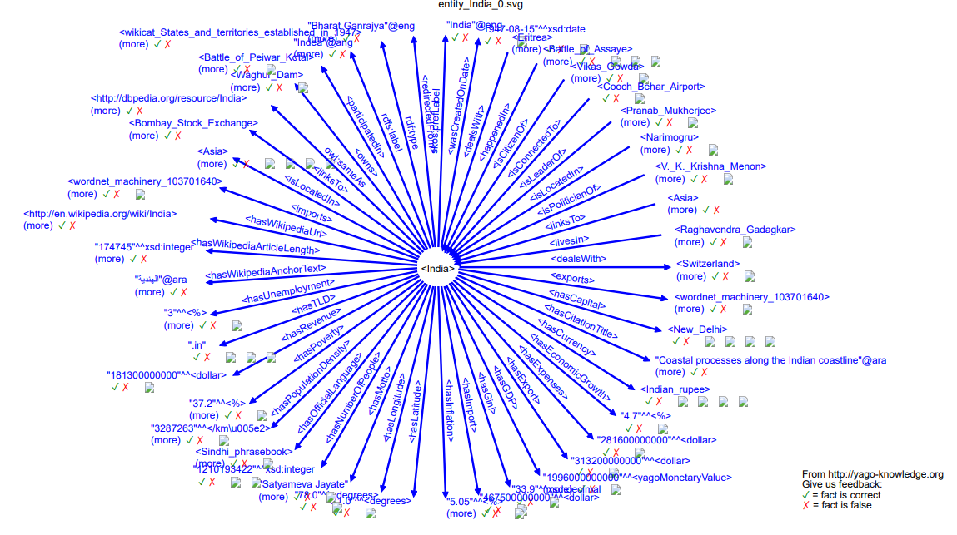
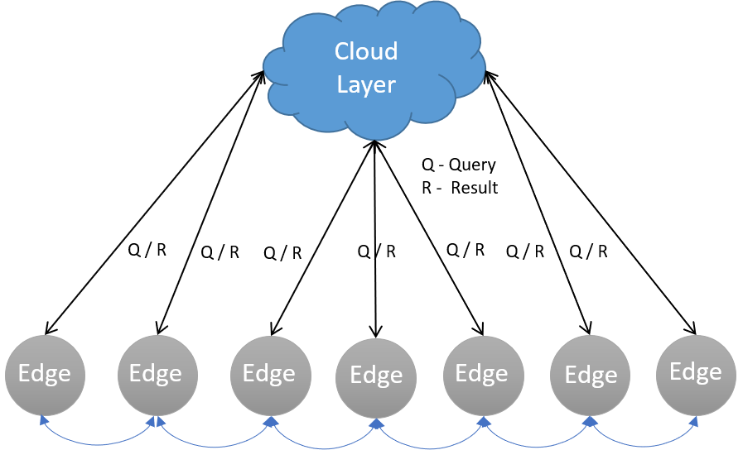
Motivation
Knowledge Graphs are huge!
Graph querying problems are hard
IoT – Heterogenous Structure
Different Compute, Storage & Network Capacity
Needs lightweight and low latency solution

Slide 3
Related Work
Graph Processing
Pregel [2]
Giraph [3]
GraphX [4]
Trinity [5]
Quegel [13]
Graph Caching
GC [6]
Graph Databases
GoDB [11]
TinkerGraph
Neo4j
Dgraph
Titan
Graph Indexing
C-Tree [7]
Views [8]
FERRARI [9]
GraphS [10]

Slide 4
Key Contributions
Graph Cache
Cache Knowledge graph in Edge layer
Query Partitioning
Partition input graph query into local and remote
Result Generation
Combine results from local and remote server into a correct result
Different Query Types
Vertex, Edge, Path search and reachability
Result Caching
Cache results from remote layer with cache management

Slide 5
Graph Caching
Associate an entity with the edge device E.g. <India>
Store the k-hop subgraph around the entity as local graph
Parameter k depends on storage and compute capacity

Slide 6
Query Partitioning
Reachability
Type 1 - Entirely contained within edge (local graph)
Type 2 - Crosses between edge and remote (local + remote graph)
Type 3 - Entirely contained within remote (remote graph)
Steps
Local Query is fired to check for Type 1 existence
If no result in previous step, remote queries are fired with source as Cut Vertices for Type 2
Local queries are fired with source unchanged and target as Cut Vertices
Remote query is also fired with original source for Type 3

Slide 7
Result Combining
Vertex and Edge Search
Set union of local and remote result set
Reachability
For non-crossing paths – trivial
For crossing paths
Concatenate local path and remote path at the Cut vertex
Take the path with minimum no. of edges

Slide 8
Result Caching

Slide 9
Experiments
Remote Graph database
1 node in-memory spawned TinkerGraph in Rigel Head Node
32 core AMD Opteron with 128 GB RAM
Centos 7
Edge Layer
4 core, 1GB RAM container
Ubuntu 18.04 LTS
Latency: 5ms & Bandwidth: 100 MBps
Dataset
YAGO minimal knowledge graph
14977 vertices, 18845 edges and 1400 total attributes
Local graph centred on <India> with 2 hops

Slide 10
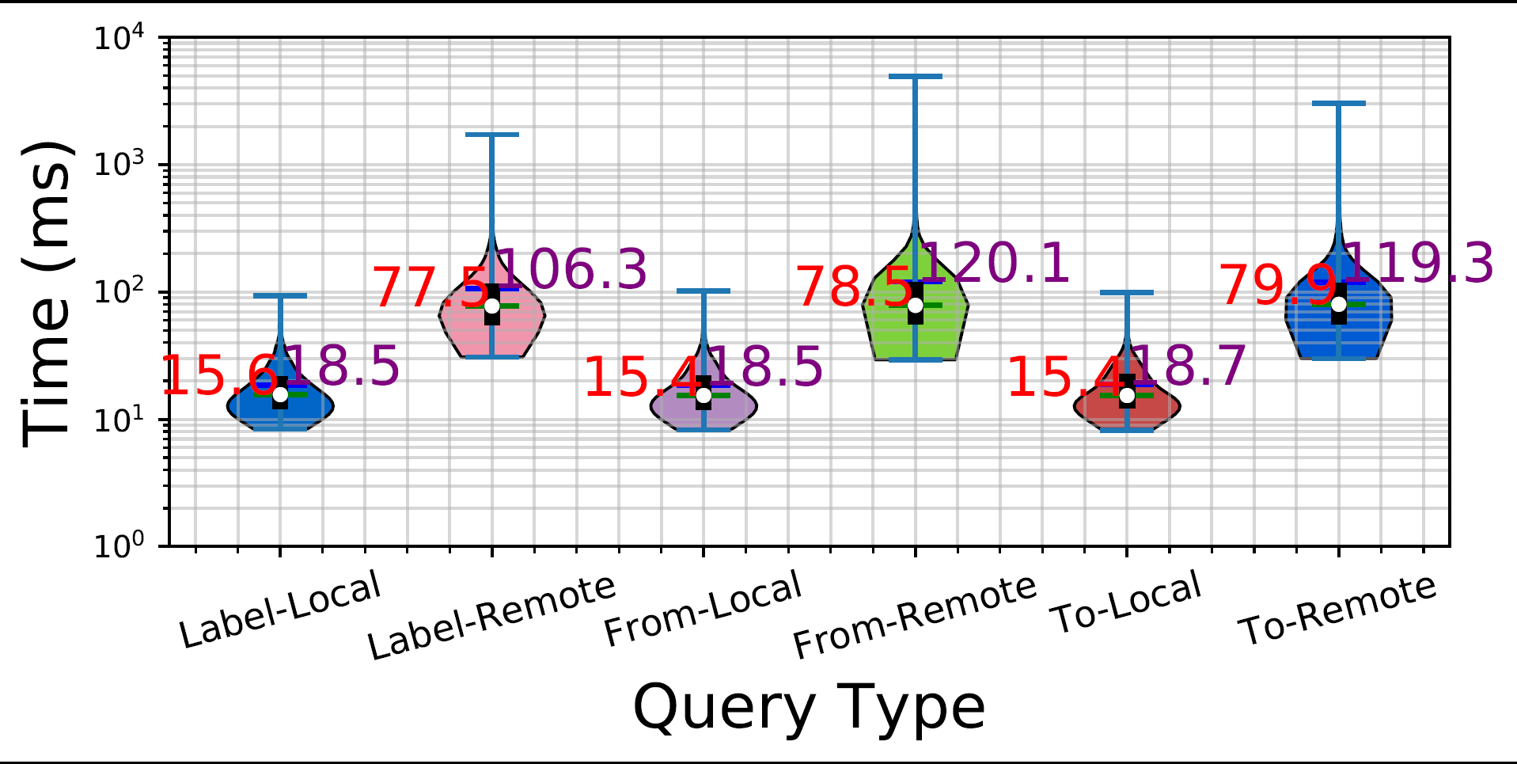
Experiments – Vertex Search

Slide 11
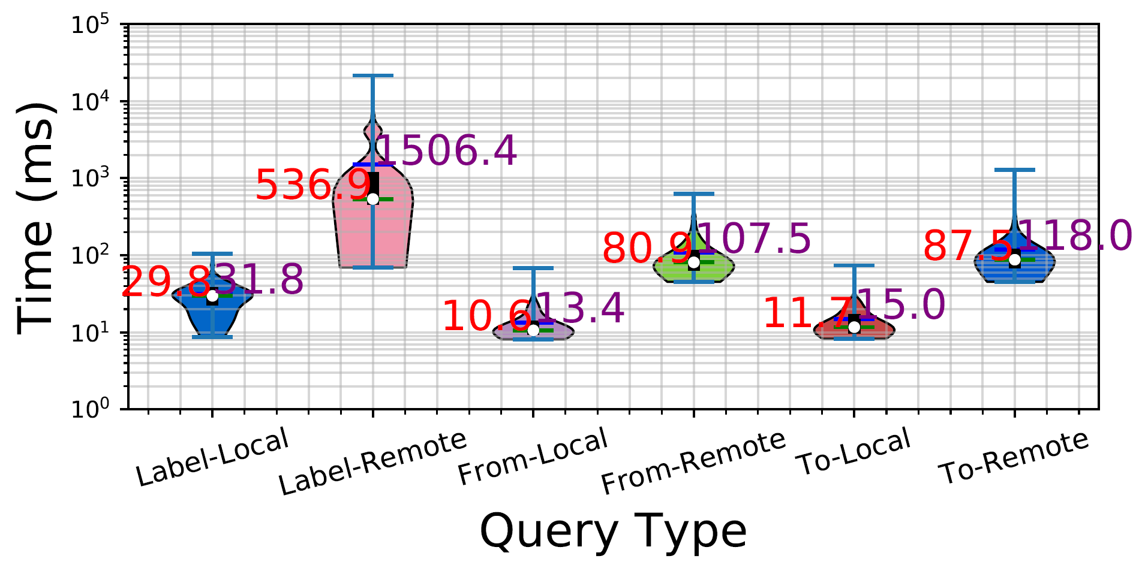
Experiments – Edge Search

Slide 12
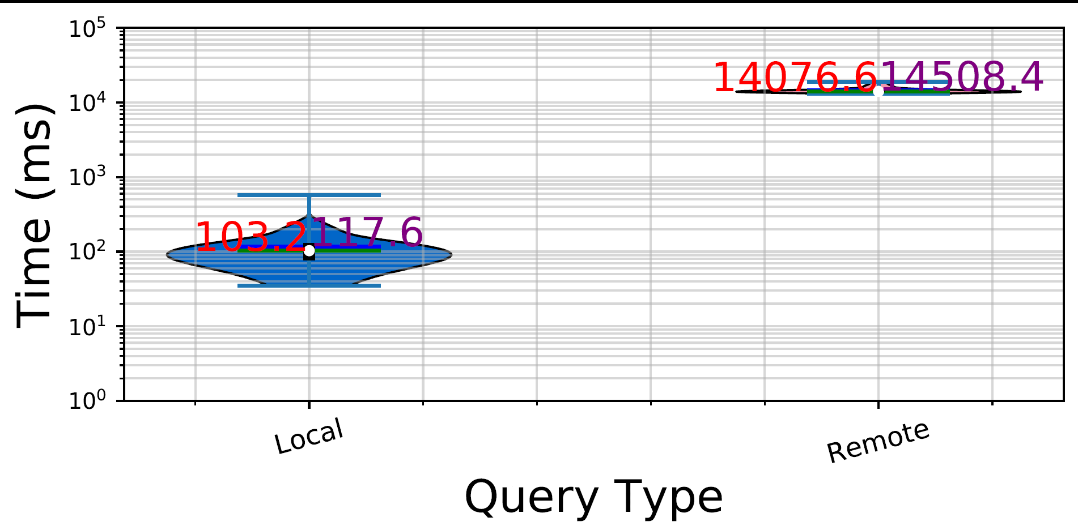
Experiments – Path Search

Slide 13
Challenges

Slide 14
Future Work

Slide 15
Original Proposal & Accomplishments

Slide 16
Demo

